Slide 1
Methods of integration for solving the Sommerfeld identity
Wissam Razouki
CSE 3802

Slide 2
Introduction

Slide 3
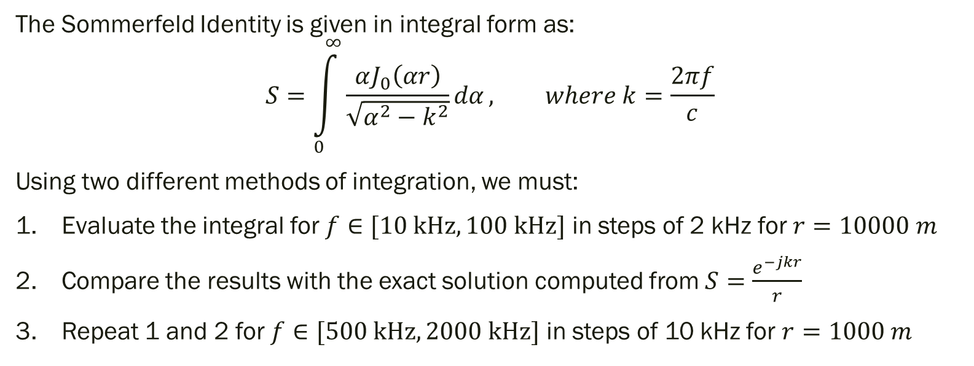
The Problem
The Sommerfeld Identity is given in integral form as:
$$S=\int_{0}^{∞}{\frac{αJ_{0}\left(αr\right)}{\sqrt{α^{2}−k^{2}}}dα}, where k=\frac{2πf}{c}$$
Using two different methods of integration, we must:
Evaluate the integral for $f∈[10 kHz, 100 kHz]$ in steps of 2 kHz for $r=10000 m$
Compare the results with the exact solution computed from $S=\frac{e^{−jkr}}{r}$
Repeat 1 and 2 for $f∈[500 kHz, 2000 kHz]$ in steps of 10 kHz for $r=1000 m$

Slide 4
Methods Used
Reference method:
The exact solution
Experimental methods:
Trapezoid method
Ruffa’s method

Slide 5
Exact solutions

Slide 6
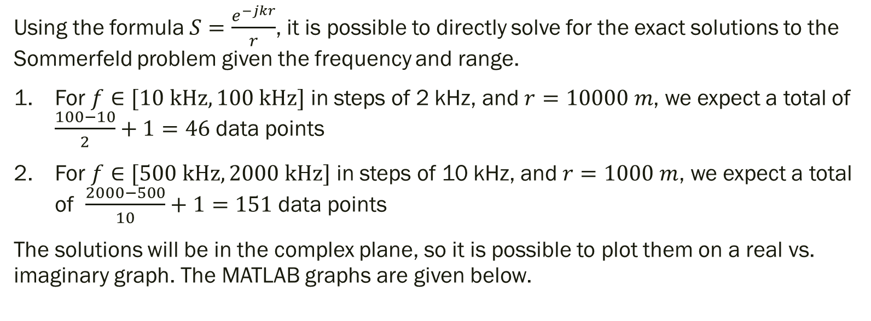
The Exact Solution
Using the formula $S=\frac{e^{−jkr}}{r}$, it is possible to directly solve for the exact solutions to the Sommerfeld problem given the frequency and range.
For $f∈[10 kHz, 100 kHz]$ in steps of 2 kHz, and $r=10000 m$, we expect a total of $\frac{100−10}{2}+1=46$ data points
For $f∈[500 kHz, 2000 kHz]$ in steps of 10 kHz, and $r=1000 m$, we expect a total of $\frac{2000−500}{10}+1=151$ data points
The solutions will be in the complex plane, so it is possible to plot them on a real vs. imaginary graph. The MATLAB graphs are given below.

Slide 7
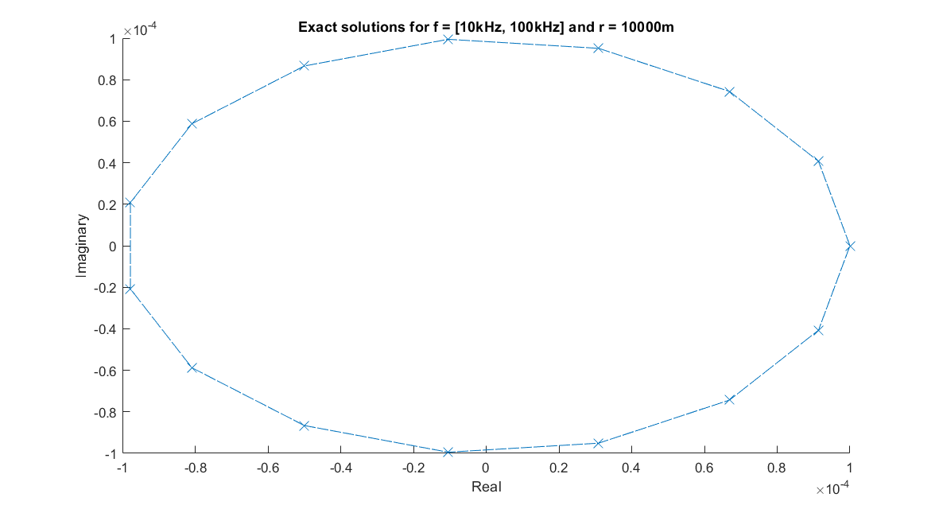

Slide 8
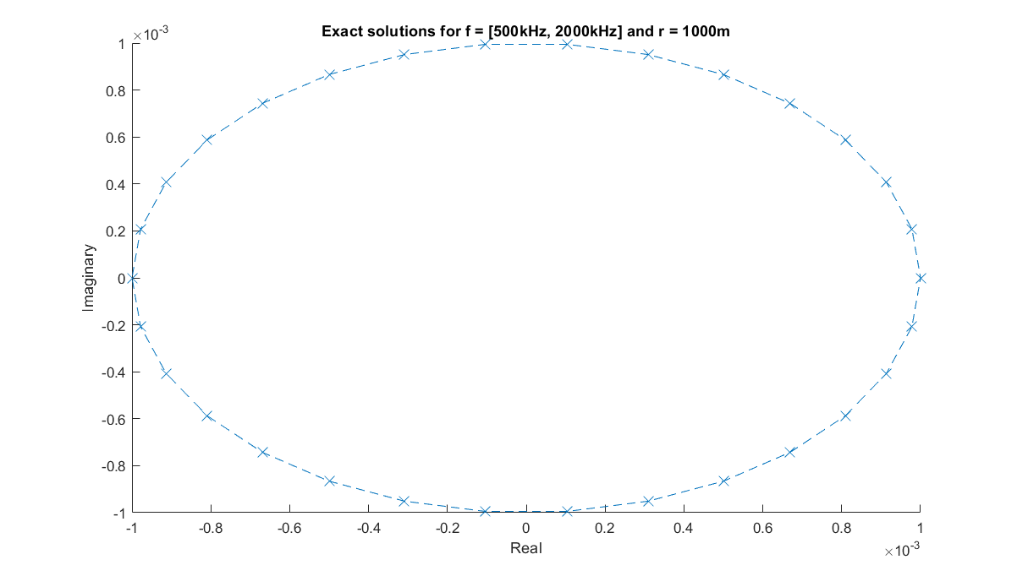

Slide 9
Analysis
Looking at these graphs, we see that the number of points (marked as X’s) is severely lower than what was calculated previously (46 and 151).
This is because, at certain frequencies, the formula produces the same solutions. Thus, multiple X’s are overlaid on top of each other
We expect this to be different for our experimental methods due to error

Slide 10
Experimental methods and solutions

Slide 11
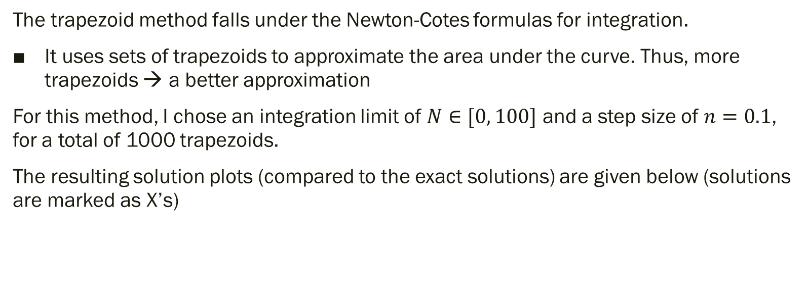
Trapezoid Method
The trapezoid method falls under the Newton-Cotes formulas for integration.
It uses sets of trapezoids to approximate the area under the curve. Thus, more trapezoids → a better approximation
For this method, I chose an integration limit of $N∈[0, 100]$ and a step size of $n=0.1$, for a total of 1000 trapezoids.
The resulting solution plots (compared to the exact solutions) are given below (solutions are marked as X’s)

Slide 12
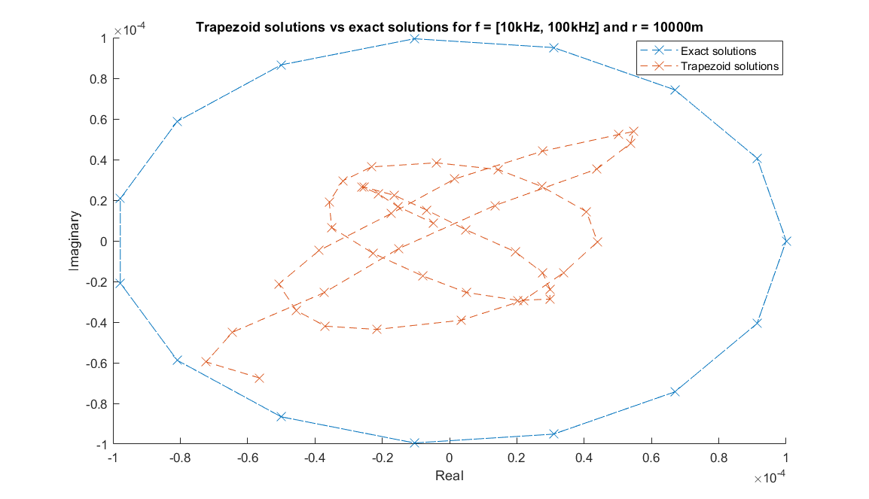

Slide 13
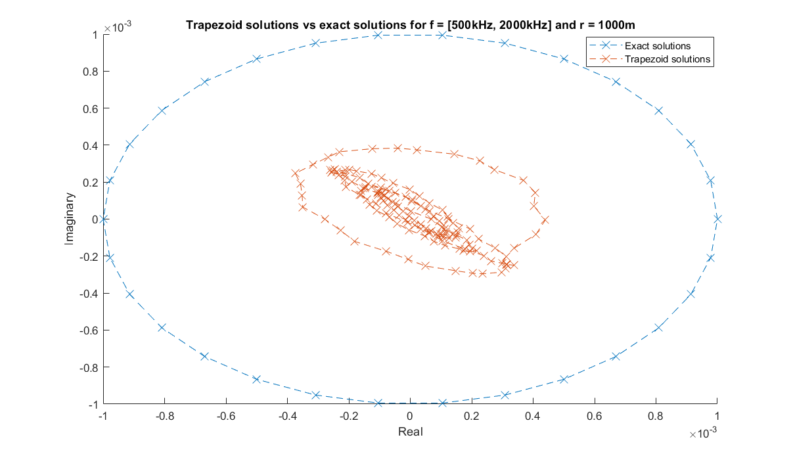

Slide 14
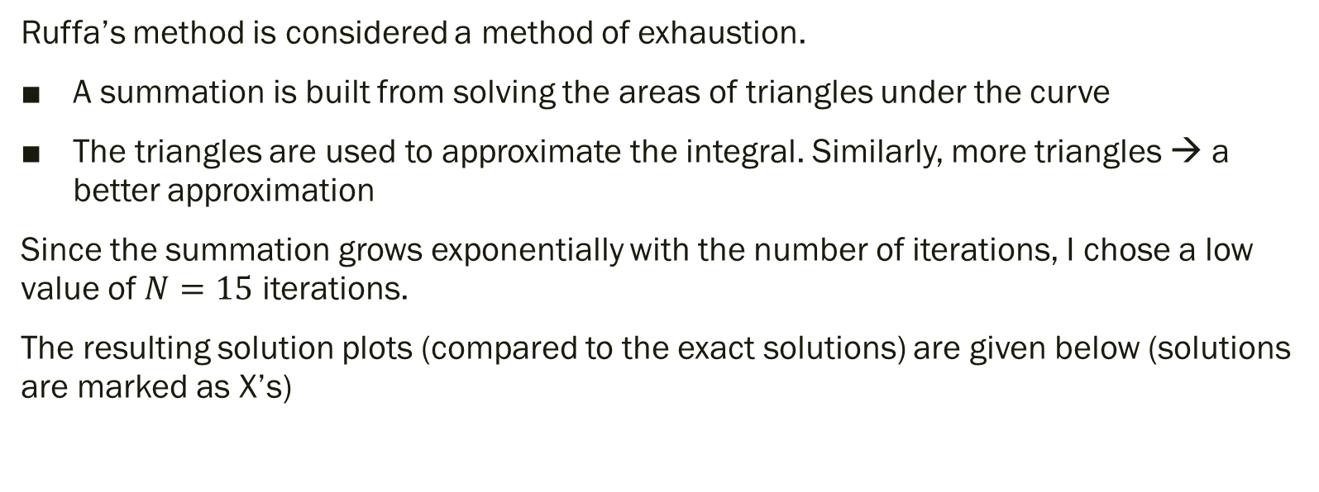
Ruffa’s Method
Ruffa’s method is considered a method of exhaustion.
A summation is built from solving the areas of triangles under the curve
The triangles are used to approximate the integral. Similarly, more triangles → a better approximation
Since the summation grows exponentially with the number of iterations, I chose a low value of $N=15$ iterations.
The resulting solution plots (compared to the exact solutions) are given below (solutions are marked as X’s)

Slide 15
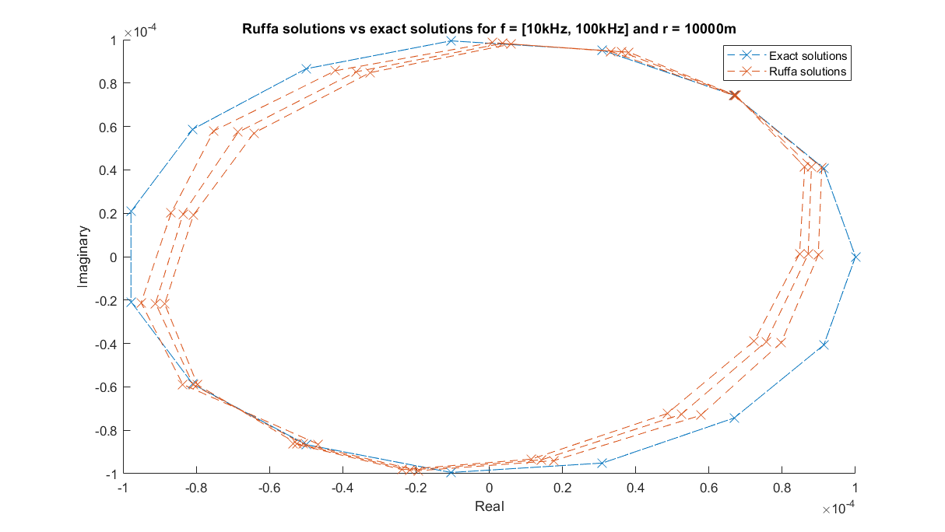

Slide 16
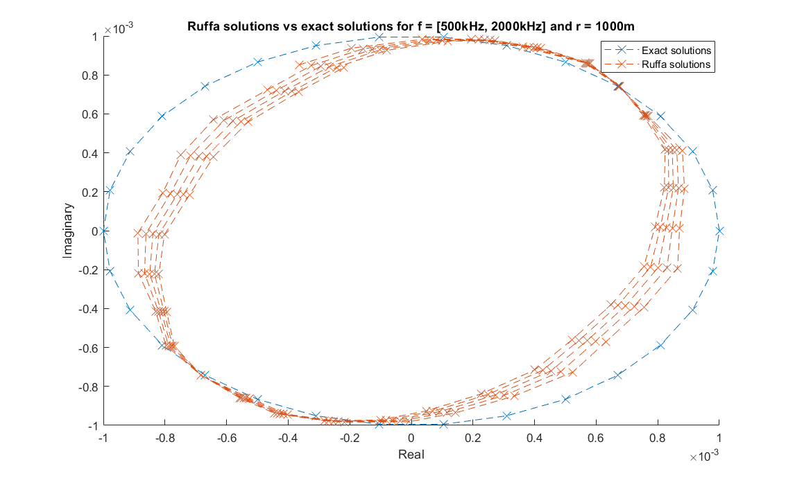

Slide 17
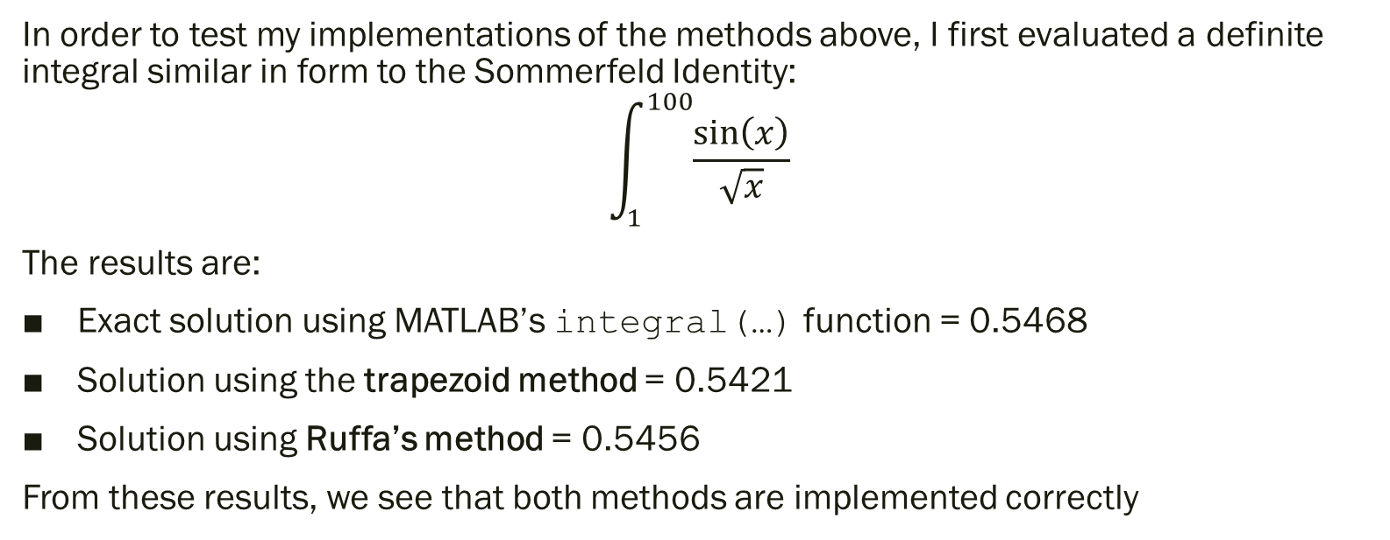
Method Verification
In order to test my implementations of the methods above, I first evaluated a definite integral similar in form to the Sommerfeld Identity:
$$\int_{1}^{100}{\frac{\sin\left(x\right)}{\sqrt{x}}}$$
The results are:
Exact solution using MATLAB’s integral(…) function = 0.5468
Solution using the trapezoid method = 0.5421
Solution using Ruffa’s method = 0.5456
From these results, we see that both methods are implemented correctly

Slide 18
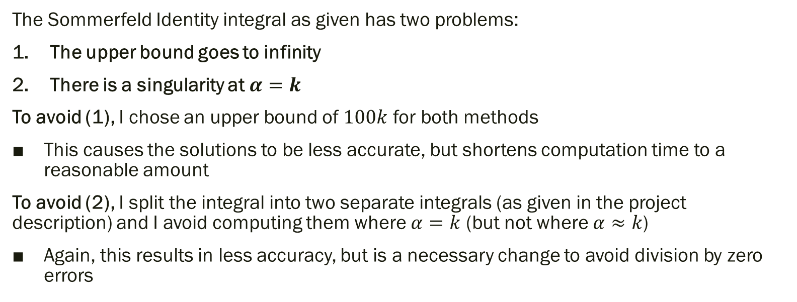
Handling Infinities and Singularities
The Sommerfeld Identity integral as given has two problems:
The upper bound goes to infinity
There is a singularity at $α=k$
To avoid (1), I chose an upper bound of $100k$ for both methods
This causes the solutions to be less accurate, but shortens computation time to a reasonable amount
To avoid (2), I split the integral into two separate integrals (as given in the project description) and I avoid computing them where $α=k$ (but not where $α≈k$)
Again, this results in less accuracy, but is a necessary change to avoid division by zero errors

Slide 19
Analysis and conclusions

Slide 20
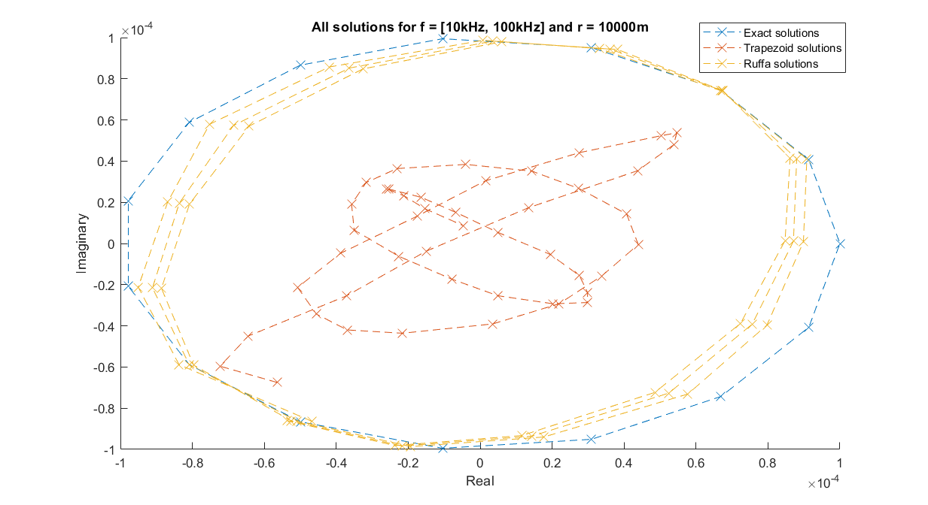

Slide 21
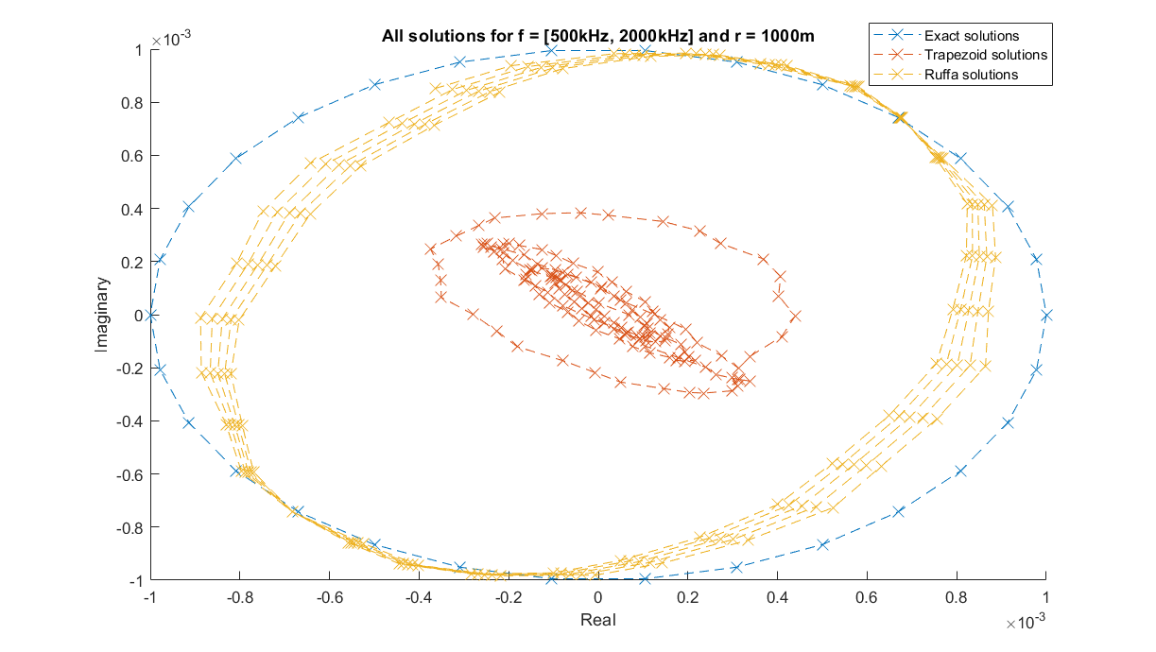

Slide 22
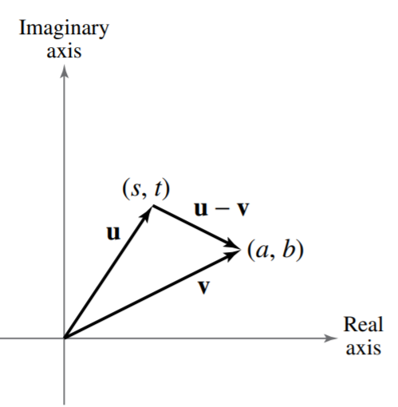
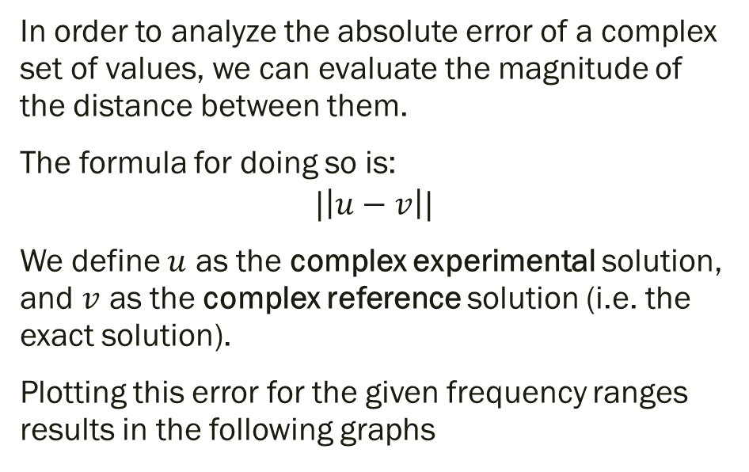
Error Analysis
In order to analyze the absolute error of a complex set of values, we can evaluate the magnitude of the distance between them.
The formula for doing so is:
$$|\left|u−v\right||$$
We define $u$ as the complex experimental solution, and $v$ as the complex reference solution (i.e. the exact solution).
Plotting this error for the given frequency ranges results in the following graphs

Slide 23
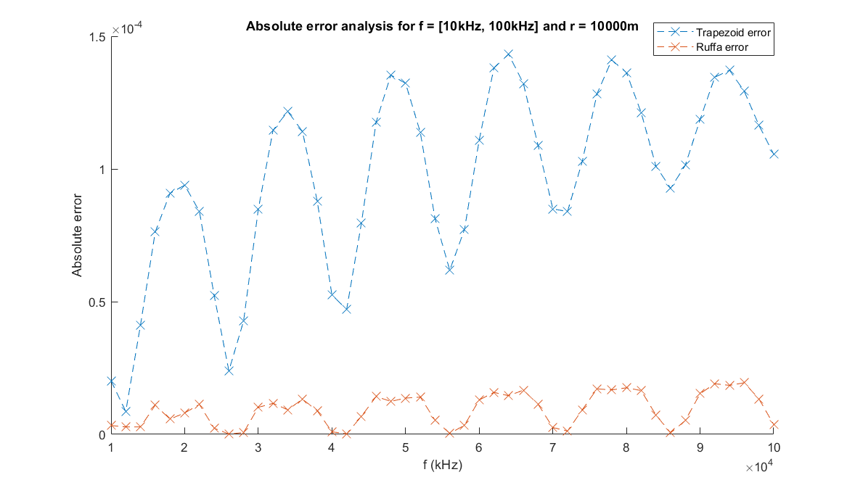

Slide 24
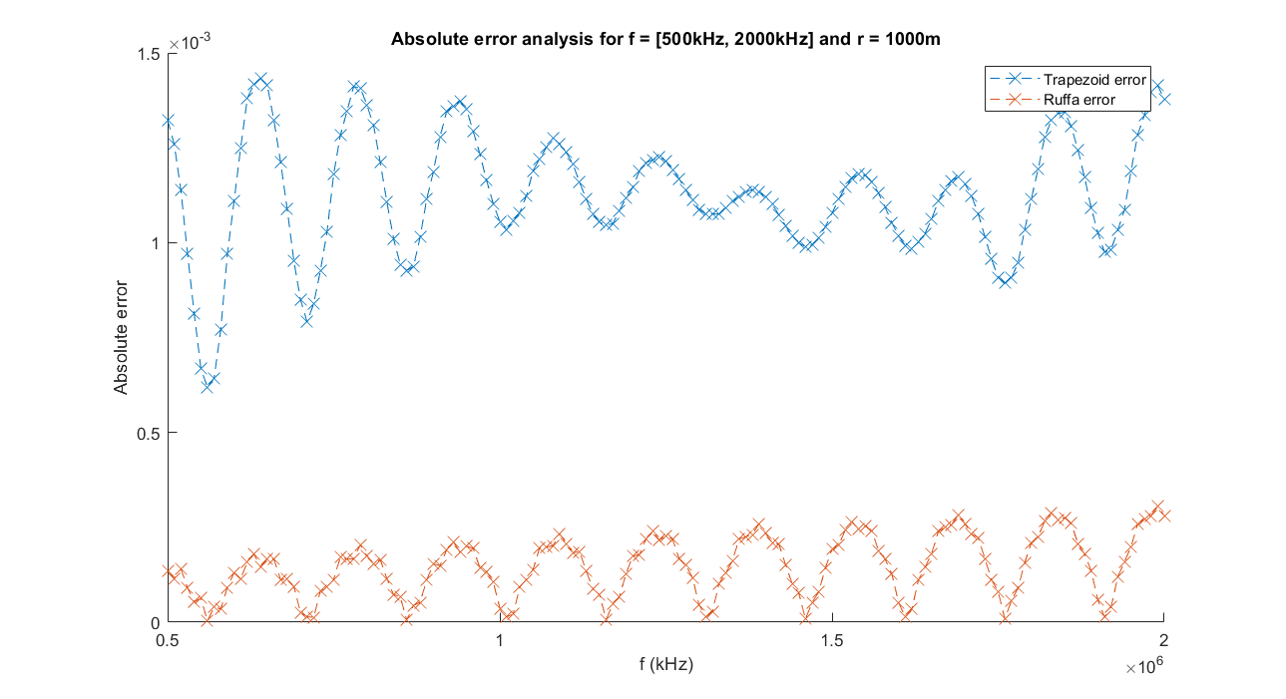

Slide 25
Conclusions and Remarks
From the data we gathered, it is obvious that Ruffa’s method worked much better than the trapezoid method. This can be attributed to a few things:
More iterations were run using Ruffa’s method
The trapezoid method did not handle complex values well
There was no error term associated with the trapezoid formula. This was done to make computation less heavy
Loss of significance due to very small values
Regardless, neither methods had any major code-breaking issues, and the waveforms for the absolute error seem consistent for both methods.

